Slide 1

FORUM
Name :- Vaishnavi Kawduji
Ghongade
Section :- NAlANDA
Mentor :- Ms.Deepika Soni

Slide 2
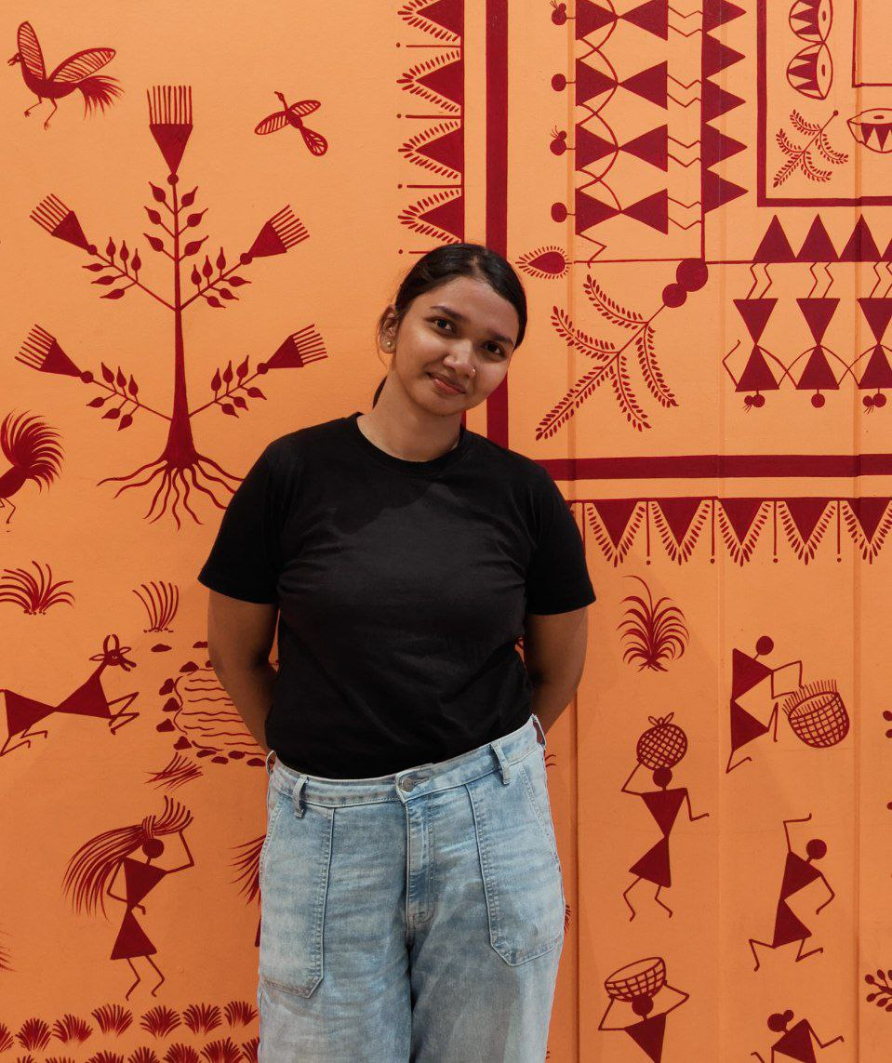
About me
Basic degree :- Bsc.Agriculture🌱🌾
Sports:-kabbadi
kho kho
basketball
Additional qualification:- poultry training
Computer Literacy:- MS-CIT

Slide 3
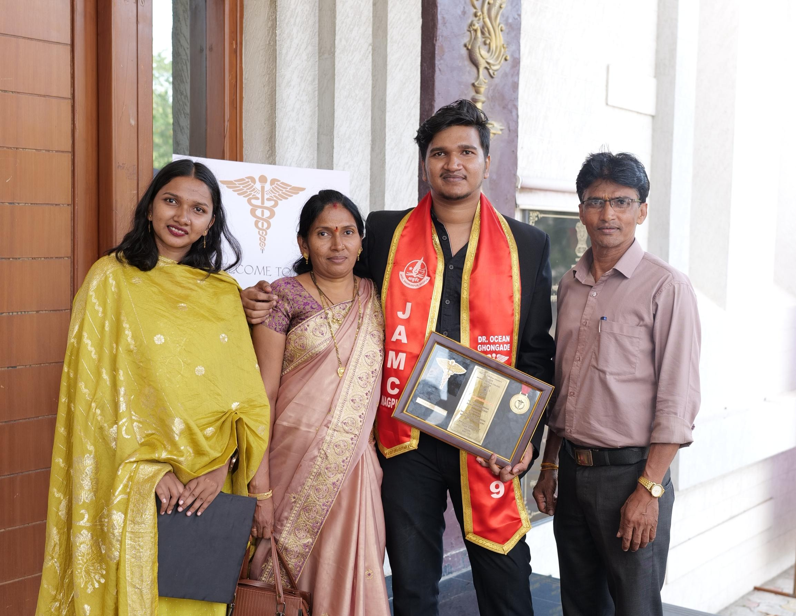
Family background
Father :- Service
Mother :- Housewife
Elder brother:- Doctor 💊

Slide 4
Why I’m pursuing MBA? Expectation?
Doesn't want to do Msc.
To build in career in mangement.
Corporate job
Build personal growth
To build management skills

Slide 5
My Targets
In the current semester
Wants to be familiar with subject
In the next three years
Working in AWL agribusiness
Ultimate objective of life
Achieving financial stability
Becoming backbone of family

Slide 6

About my likes

Slide 7
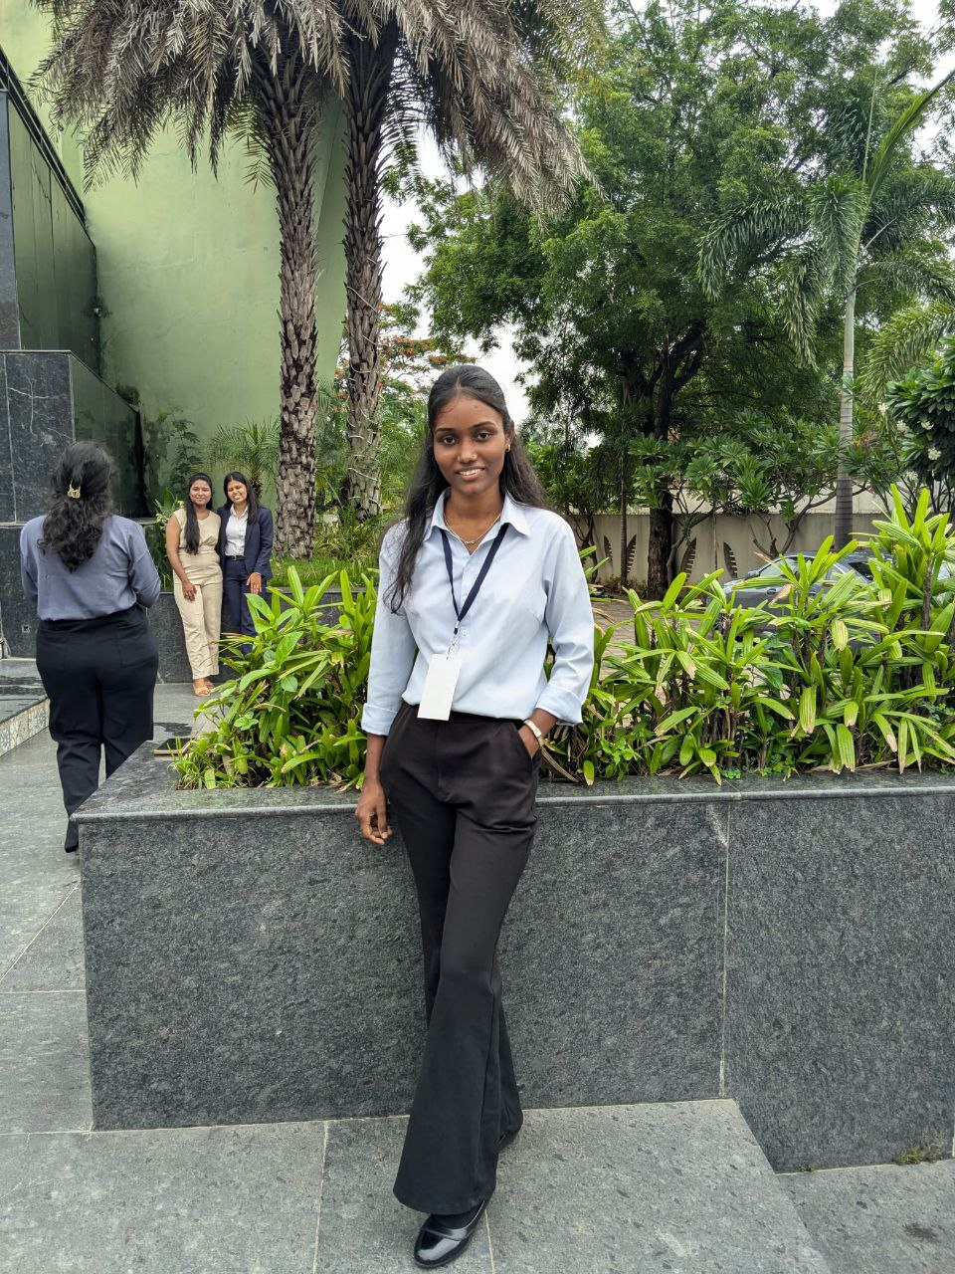
Best friend
Why best?
YOGITA SAHU
To every problem, have solution.
Practical
Known as fire brigade 🚨

Slide 8
Favorite color
White
Why it’s favorite
Peace

Slide 9
Hobbies
Sketching mandala art
Love to watch anime
Dancing

Slide 10
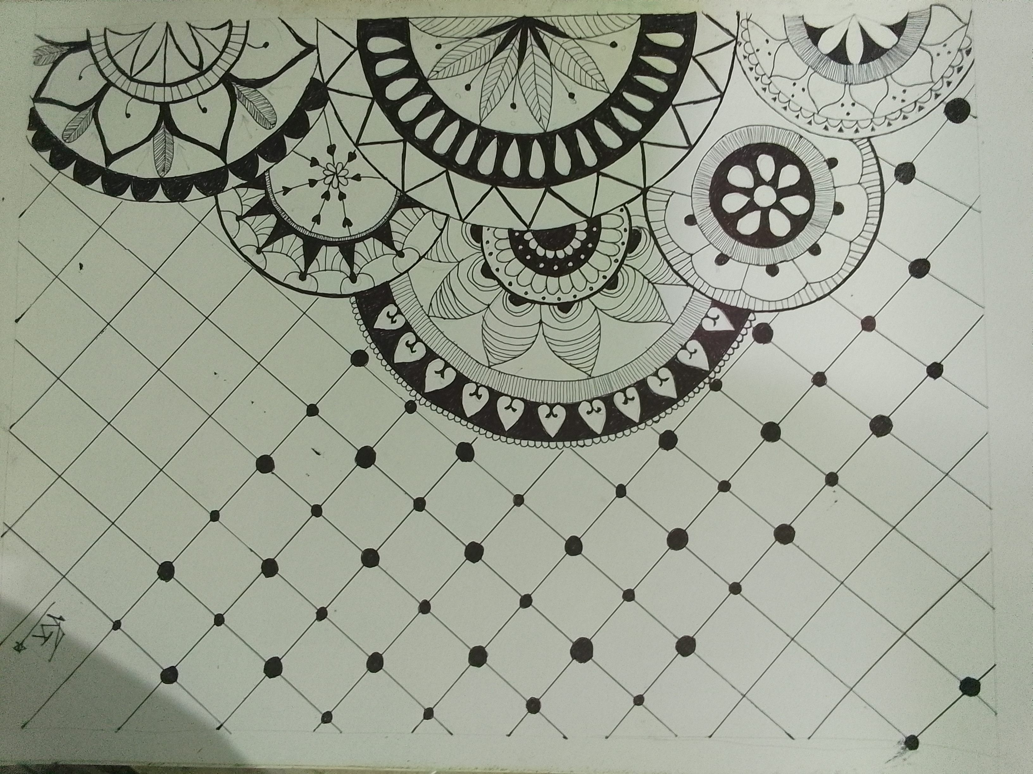

Slide 11

Sports

Slide 12
LIKE
HATE
Horror games
Travel
Food
Communication
Making new friends
Animals
Nothing

Slide 13
When I get confused ,I
Take deep breathe .
Write on the paper ,why am I confused.
Write the answer
And find the solution

Slide 14
I am deeply interested in
Anime

Slide 15
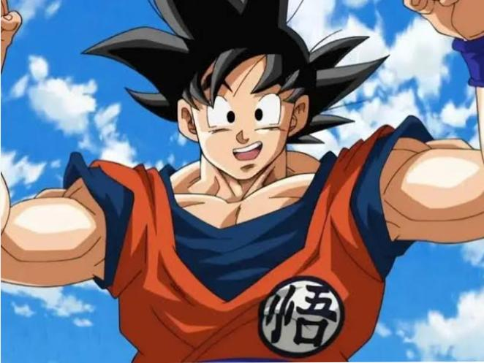
The person I admire the most
Why
Goku
Strength and power
Pure hearted and kind
Loyal and protective
Positive attitude
Often pushing himself to his limits

Slide 16
Past incident which makes me feel good about yourself

Slide 17
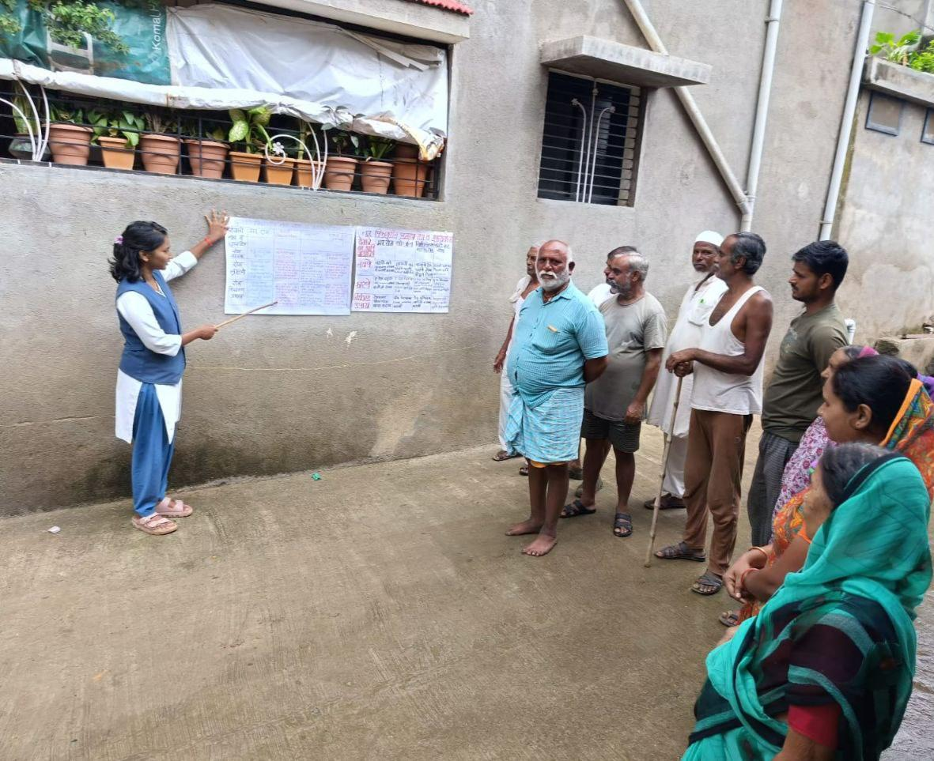
Past incident where I demonstrated my leadership skills
RAWE (rural awareness and working experience)

Slide 18
Comment on ‘BOYS ARE BETTER MANAGERS’
Yes ,I agree the best example is FATHER (Head of the family )
Manages from shoes to our school bag

Slide 19
STRENGTH
Weaknesses
1.Practical skills
2.Commuication skill
3.Reasearch and analytical skills
4.Learning skills
1.Overthinking
2.Emotional
SWOT ANALYSIS
Opportunities
Threats
1.Government exams
2. Learning ability
1.Competition for job

Slide 20
Most interesting things about my surroundings
Friends who supports when me in my bad time.
Relatives who doesn’t judge me on my abilities.

Slide 21
Changes I expect in myself after MBA
Management skills
Adaptability
Better communication
Understanding business principle
Leadership skills
Strategic thinking

Slide 22

.

